Slide 1
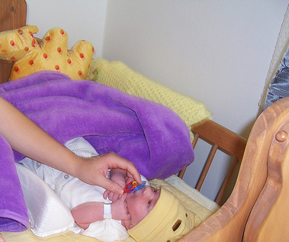
The Hand That Rocks the Cradle…
Dr. Rick Griffith, Crossroads International Church Singapore
cicfamily.com & BibleStudyDownloads.org

Slide 2
Black

Slide 3
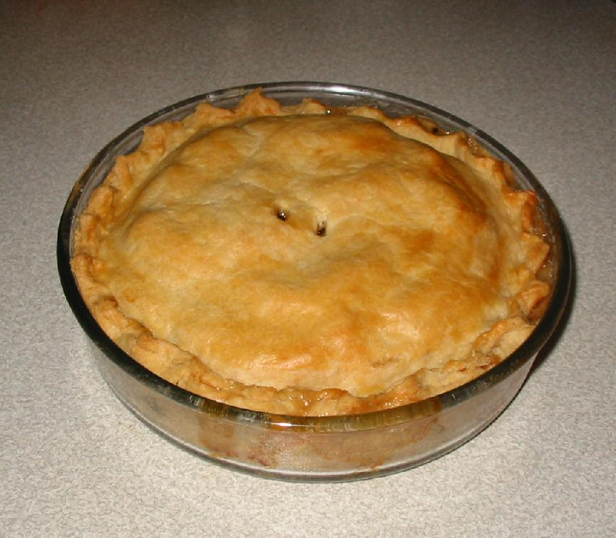
Pie
Notes:
A schoolteacher giving a lesson in fractions asked, “Johnny, suppose there were 7 in your family—a mother, a father, and 5 children. And suppose there was pie for dessert. What fraction of the pie would you get?”
Johnny answered, “One-sixth.”
“But don’t you understand?” replied the teacher. “Don’t you know about fractions?”
“I know about fractions and I know about mothers too,” remarked Johnny. “Mom would say that she didn’t want any!” ("Mother" tract) Isn’t that kind of selflessness so typical of a mother—to work so hard on something that she herself does not enjoy?

Slide 4
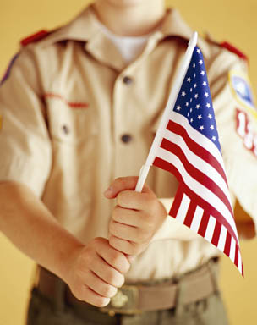

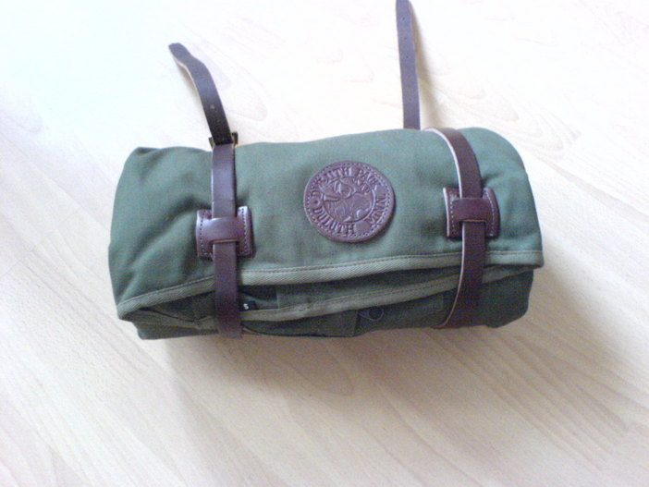
Umbrella
Notes:
During inspection on a Boy Scout outing, a scoutmaster found an umbrella hidden in the bedroll of a young camper. Puzzled, the scoutmaster asked, "Why did you bring an umbrella on a scout trip? The tenderfoot sighed, "Sir, did you ever have a mother?"
("The Fine Art of Mothering" tract)

Slide 5

Mothers
Notes:
That's just like a mother—one of the most difficult yet rewarding careers available. One writer notes, “Isn’t it strange how we elevate careers and lower homemaking to the commonplace? Think how many skills a mother must possess to carry out her duties.

Slide 6
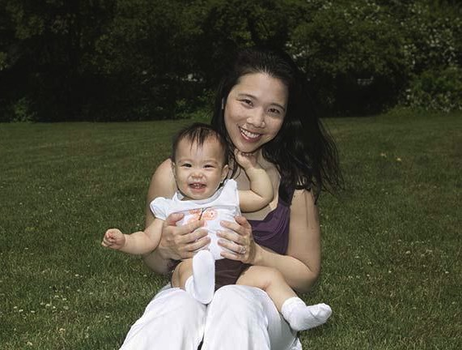
Tremendously Skilled!
Notes:
She must know something about teaching, interior decorating, cooking, dietics, psychology, hygiene, social relations, clothing, household equipment, and a host of other things.”

Slide 7
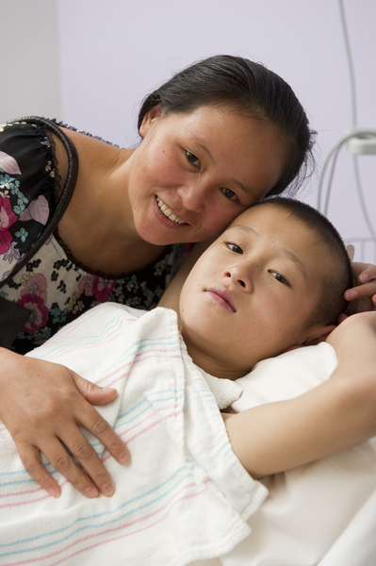
M.D. (Mother Doctor)
Notes:
“Still, if a woman teaches someone else’s children she is given professional status—a teacher. But if she teaches her own children, she is just a mother. If she does interior decorating she is a career woman; but if she decorates her own home, she is just a homemaker.

Slide 8
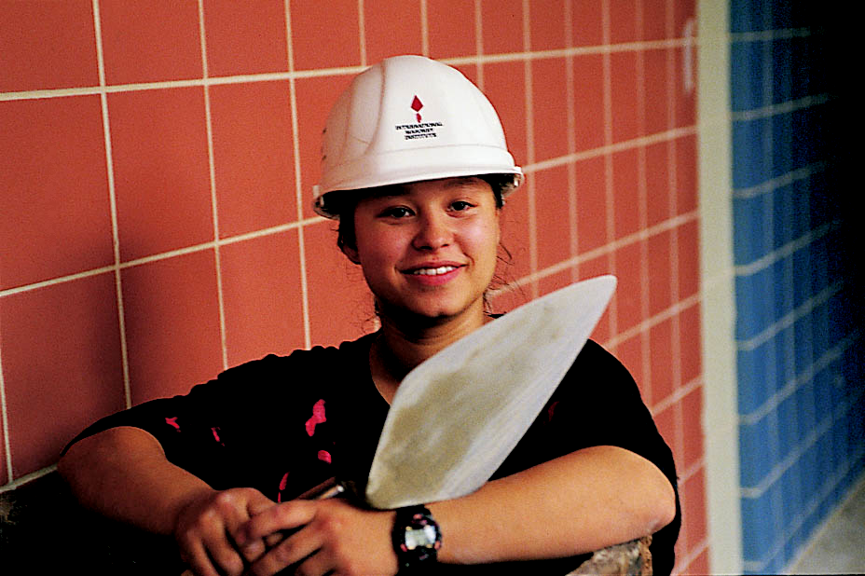
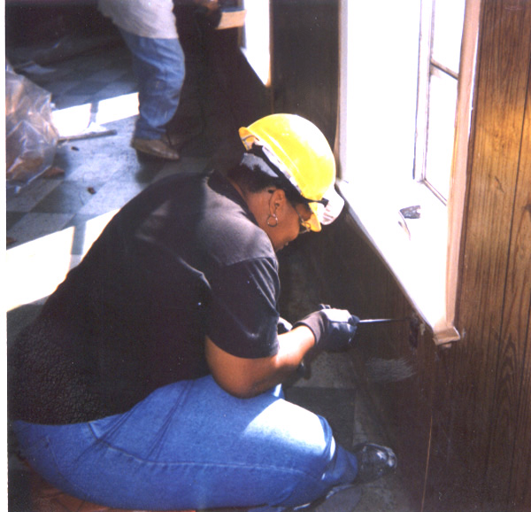
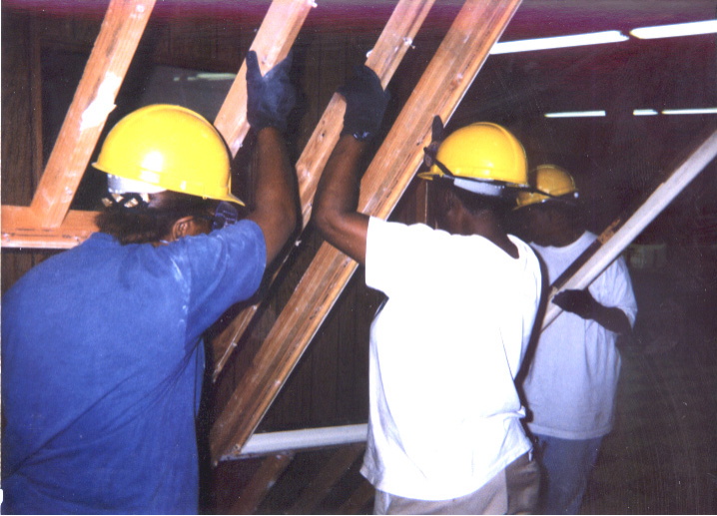
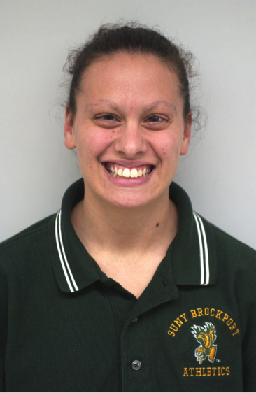
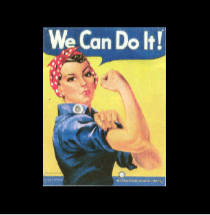
WOW
Bricklayer
(Wider Opportunities for Women)
Electrician
Carpenter
Coach
Notes:
If she takes care of others, she’s a nurse; but if she nurses her own children, she’s just ‘mom’ doing her job” ("Mother" tract). Yes, motherhood demands many skills that we easily overlook to reward "career women."
www.work4women.org/multimedia/ photos.cfm

Slide 9


Notes:
Because of her great position and influence, it is fitting to honor Mom today.

Slide 10
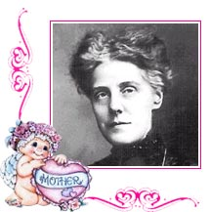
The Founder of Mother's Day
Anne Jarvis (died 1948)
Notes:
The practice in America of setting aside every second Sunday in May to honor mothers was first practiced in Philadelphia, initiated by Miss Anne Jarvis who lobbied for many years with several Presidents to get the day initiated nationwide.
Perhaps Miss Jarvis got the idea from England's "Mothering Sunday"—a custom where everyone on Mid-Lent Sunday attended their mother church where they were baptized.
The history of Mother's Day actually extends back to ancient Greece. The Greeks celebrated a festival pretty much amounting to mother worship.
But the practice of honoring mothers didn’t start in America. It goes back even further to OT times. The fifth commandment says, “Honor your father and your mother.”

Slide 11

"Honor your father and mother..."

Slide 12
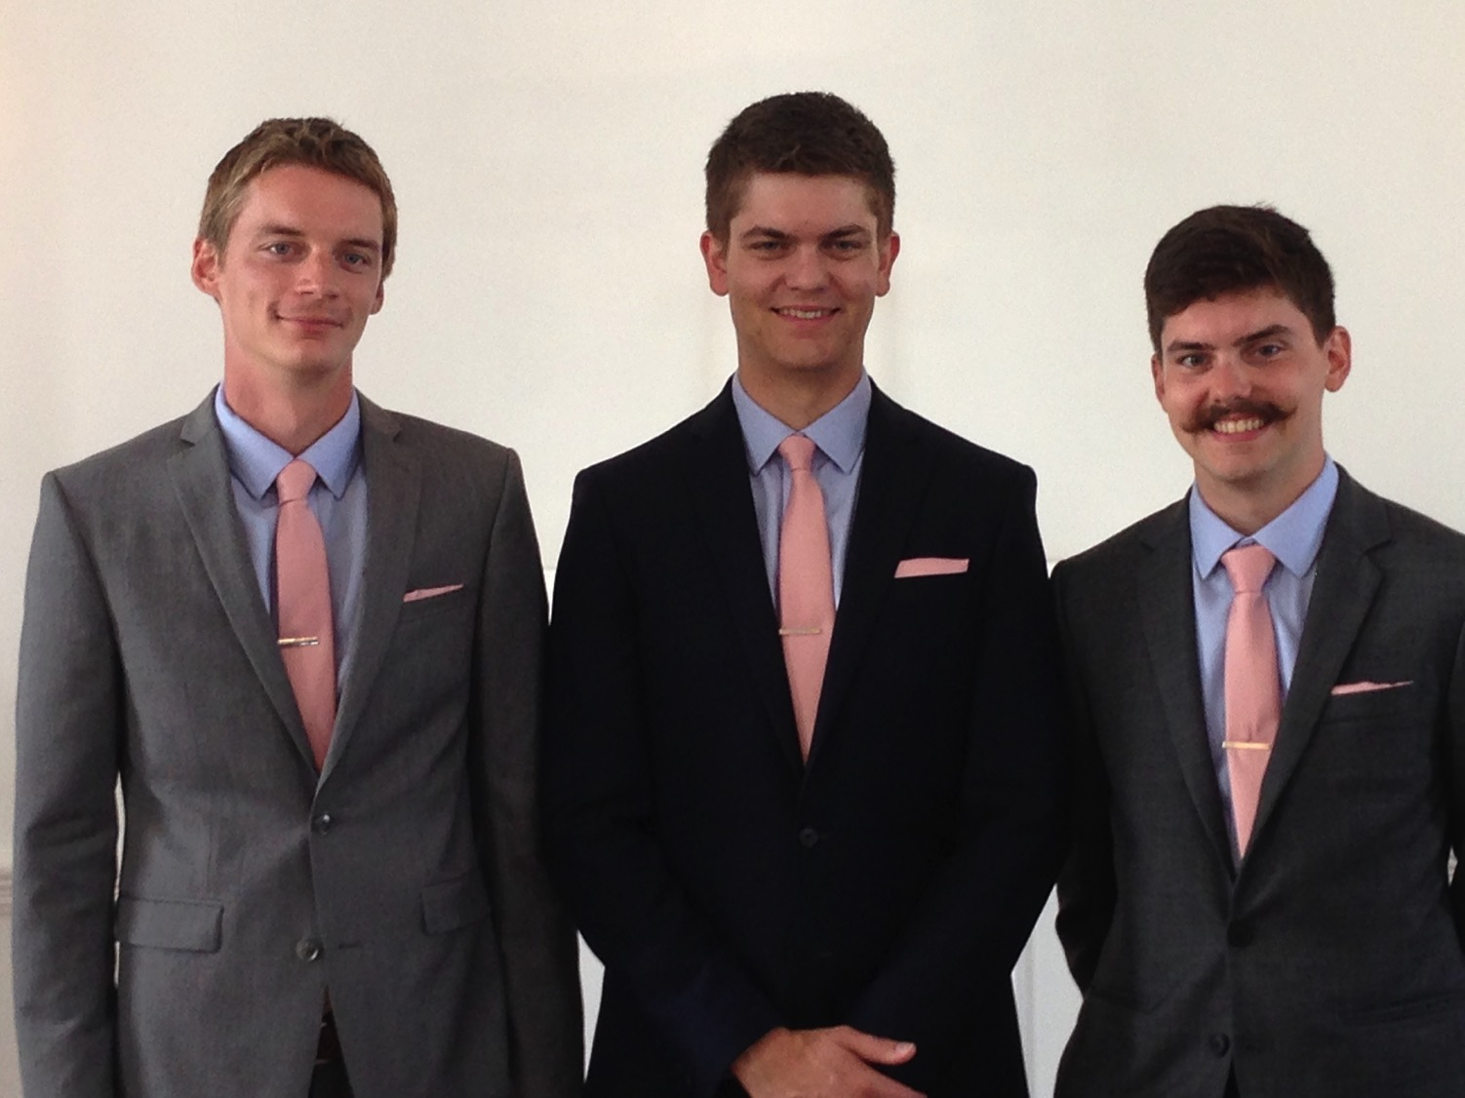
Our Three Sons

Slide 13
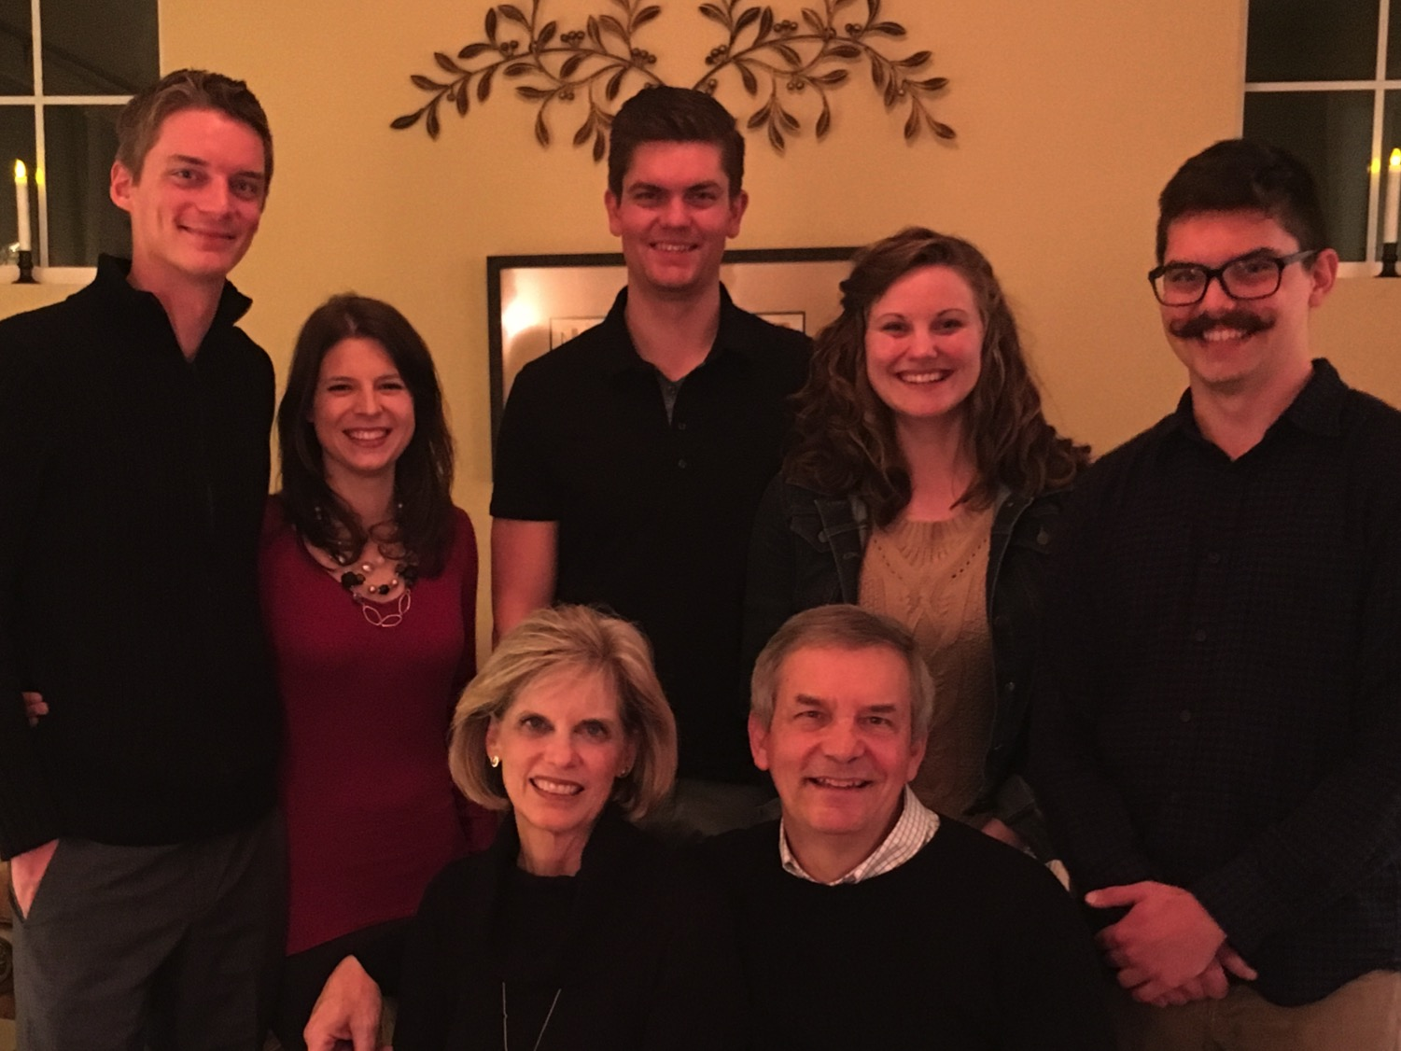
The Griffiths
9 Jan 2016
2017
Stephen & Katie (27)
John
(24)
Kurt & Cara (30)
Susan & Rick

Slide 14
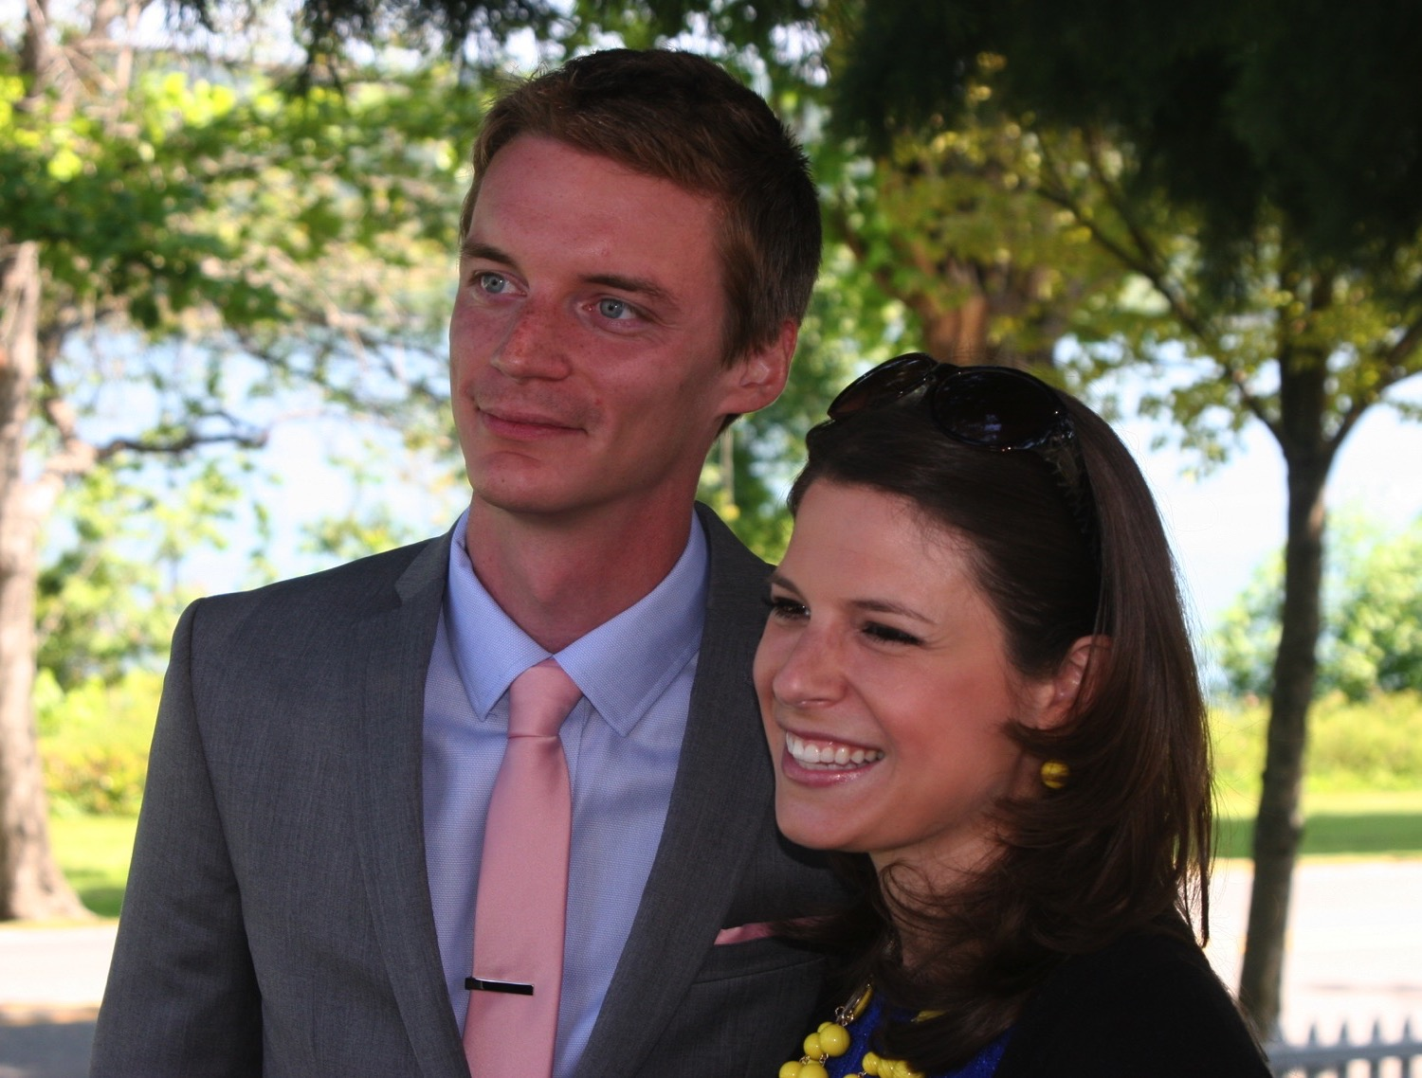
Kurt (30) works in IT and lives in Seattle

Slide 15
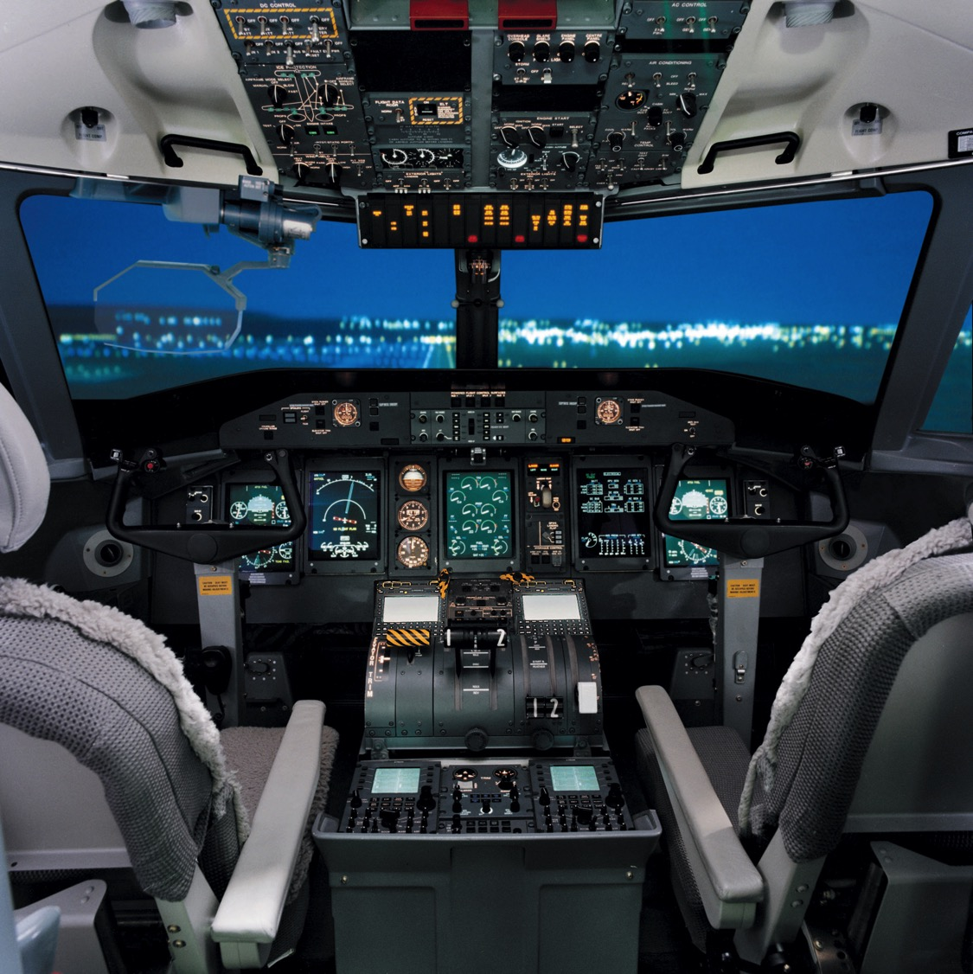
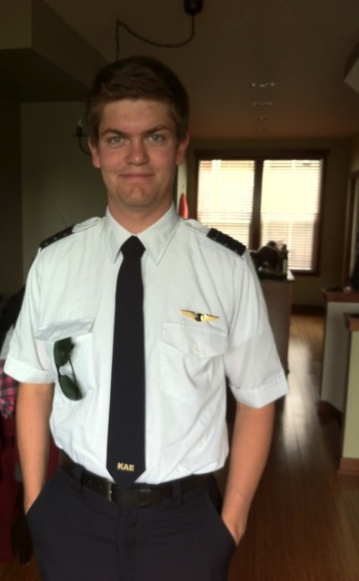
Stephen is a pilot with Spirit Airlines, Boise, Idaho
6

Slide 16

Spirit Airbus A320
8
Stephen's Plane

Slide 17

Stephen flies 174 passengers
8

Slide 18
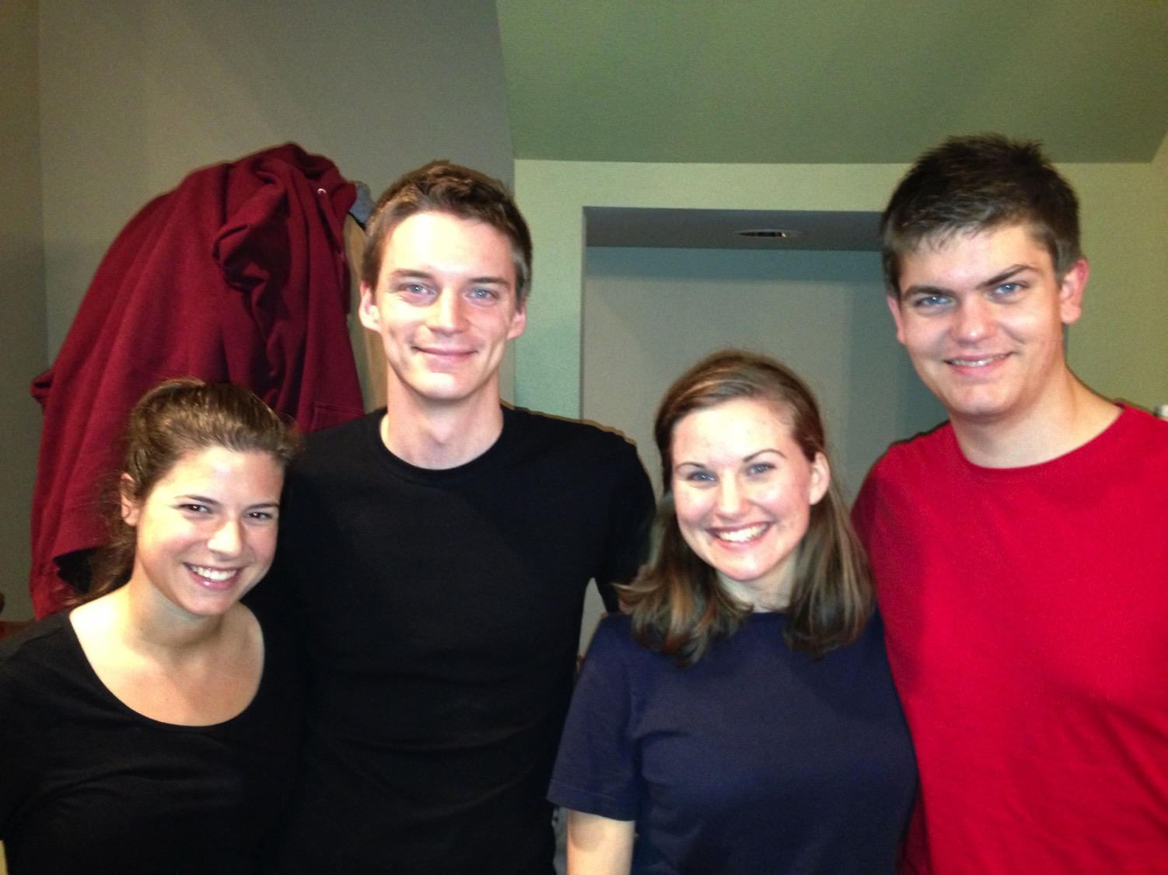
Cara & Kurt • Katie & Stephen
8

Slide 19
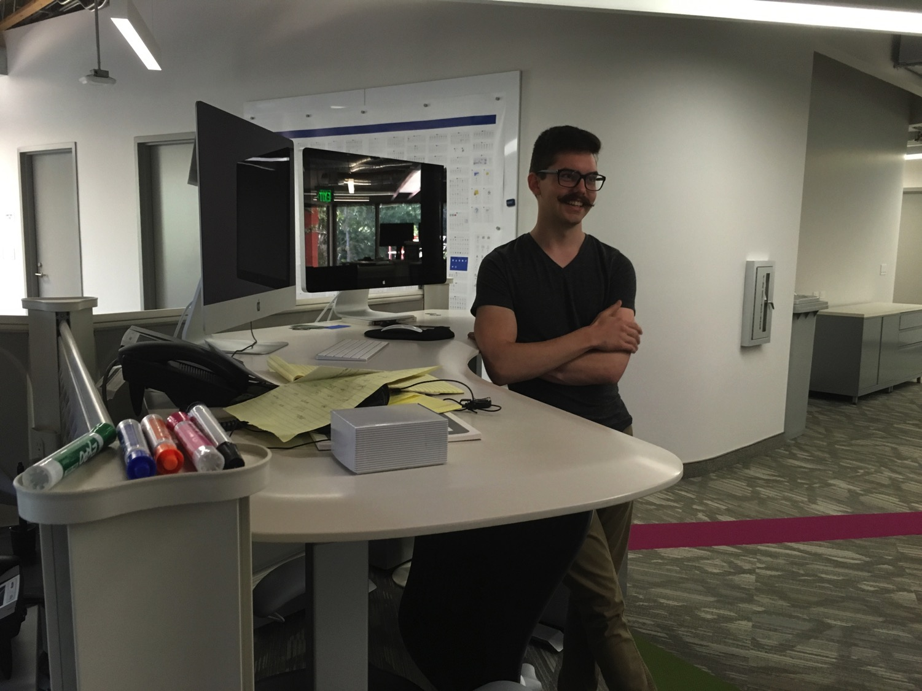

John (24) is a graphic artist in Redlands, California
8

Slide 20
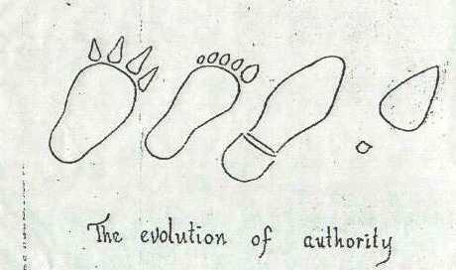
Women Have Increasing Influence in Society
Notes:
If I asked you who made the greatest influence in your life, what would you say? Why do you hold certain values and priorities over others? What source molded you that way more than any other? TV? School? A certain friend or teacher? The Bible? Think about it long enough and you will agree that it is your mother—for good or ill.

Slide 21

Main Idea:
A mother's influence is the most powerful force in the world!
Notes:
Today we will see in the Bible some excellent examples of influential mothers who passed on a spiritual heritage to their children. My prayer is that you will be convinced that mothering is the most influential and important job in all the world [main idea]. There’s no more significant work than shaping the lives of the next generation [restatement].

Slide 22
2 Timothy 1:1-11

Slide 23

I. Timothy trusted Christ through his mother and grandmother
(2 Tim. 1:5).
Notes:
Timothy became a disciple by the influence of these two most important women in his life.

Slide 24
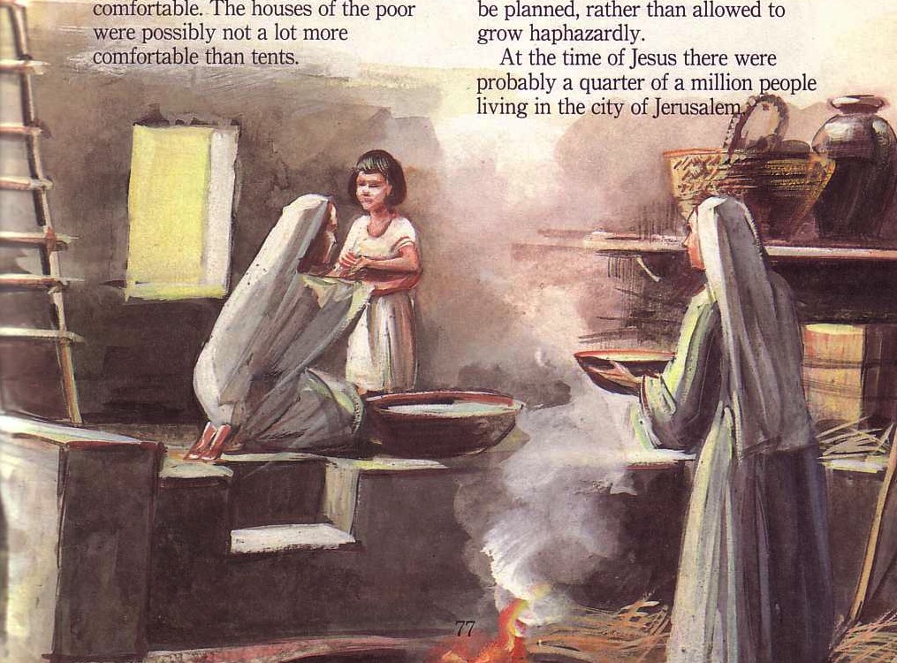
Timothy's Influencers
Mother: Eunice
Grandmother: Lois
Notes:
Notice how Paul claims that the women in Timothy’s life had the greatest spiritual impact.

Slide 25

Paul's First & Second Missionary Journeys
Notes:
I find it interesting that Timothy's father is not mentioned here—but Paul met Timothy on his second missionary journey and when you look at Acts 16:1 you notice that Eunice was a Jewish Christian but Timothy's father was a Gentile—probably an unbelieving Gentile.

Slide 26
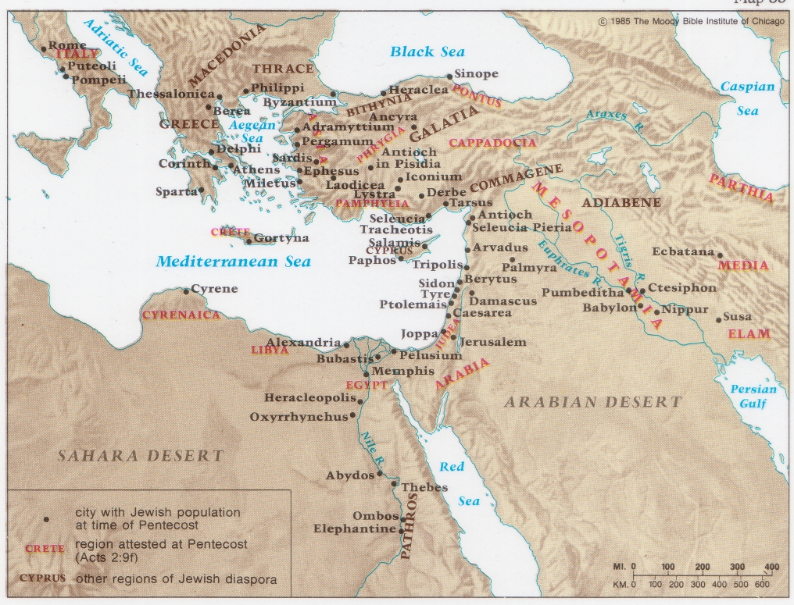
Jewish Diaspora at Pentecost
Notes:
Jews lived all over the Roman world.

Slide 27
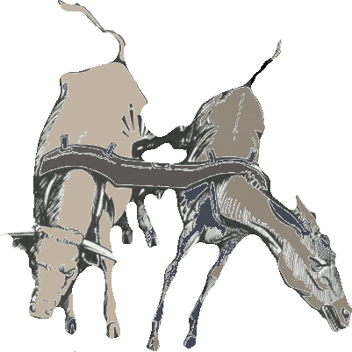
Unequal Yoke
Notes:
So we have a boy here born of a mixed marriage—not only between a Jew and a Gentile, but probably a believer and an unbeliever.
Somehow Eunice made a mistake by marrying a non-Christian or else became a Christian after the marriage—yet that wasn't going to stop her from having a godly influence on young Tim's life.

Slide 28
Black
Notes:
No doubt some of you find yourself in a similar situation—raising children without the influence of a godly father over them to supplement your efforts.
Let the example of Eunice encourage you. Don't worry that as a sole believing parent that you can't provide the kind of spiritual nurture as other families with two parents.

Slide 29

"No man is poor who has a godly mother"
--Abraham Lincoln
Notes:
He was right!

Slide 30
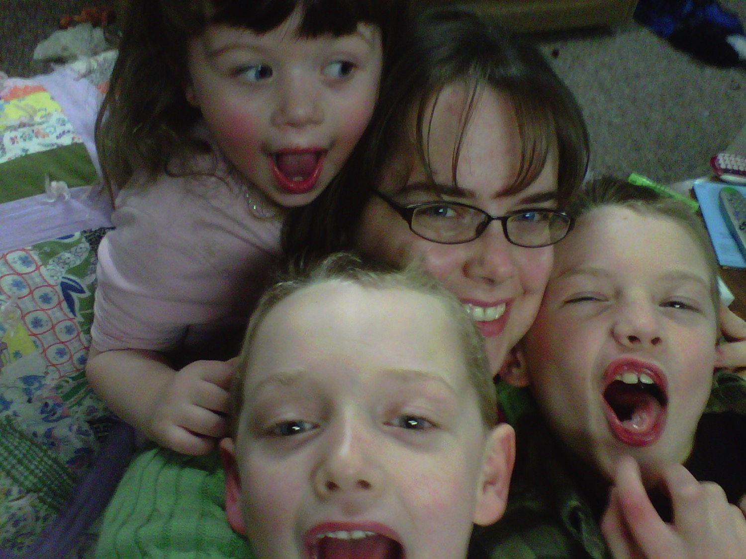
Black
Notes:
Mothers, as your kids grow up and reflect upon you what will they remember most?
Some remember their mom's depression more than any other trait.
One man's most vivid memories are of his mother's anger.

Slide 31

This is My Life
A Family Album
Notes:
Today I thought I'd share something I know something about—what God has done in my own life

Slide 32
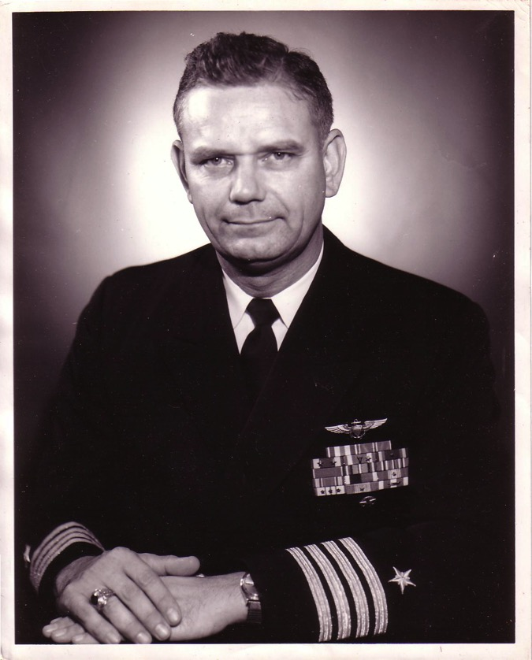
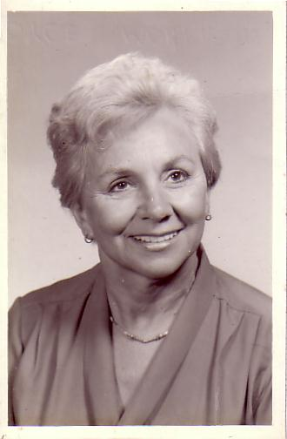
The Marriage
Navy Lieutenant
Harold F. Griffith (alias Dad)
Navy Ensign
Joyce I. Griffith (alias Mom)
Notes:
The story, of course, must begin with my parents who met in the Navy.
They had a baby boy (my older brother Bob) and then were transferred to Japan.

Slide 33
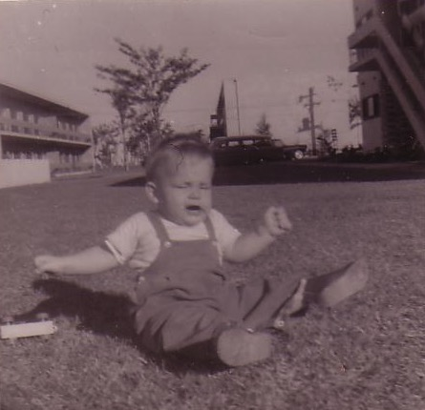
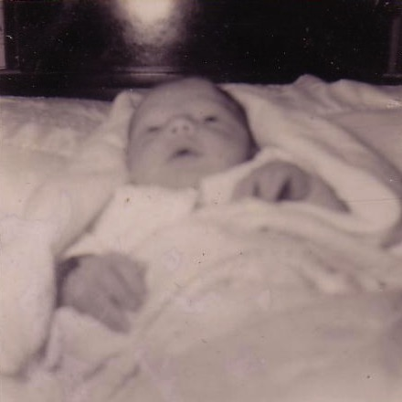
Baby Ricky
"Unto us a child is born… unto us a son is given…"
Tokyo, 1958
Notes:
That's where I made my appearance. I was born in Japan at a very young age… as an MK (Military Kid)

Slide 34
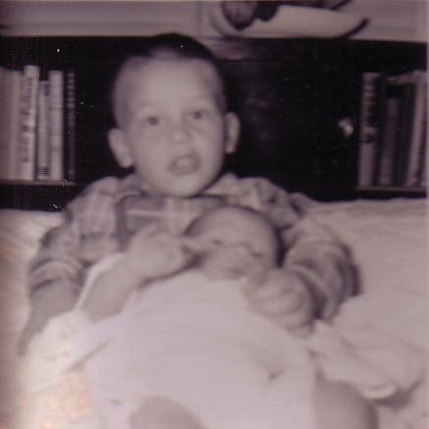
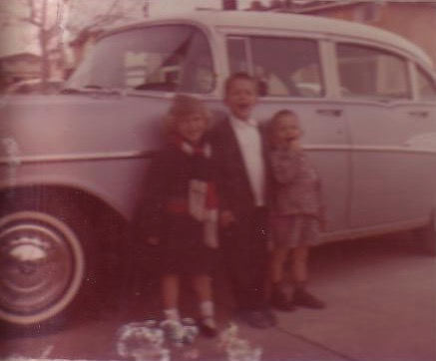
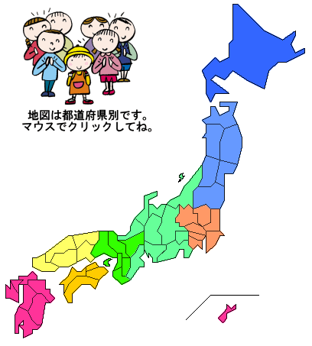
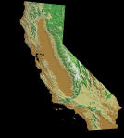
The Family Grew & Moved…
Notes:
After my sister's birth there 19 months later we moved to a strange land—California!

Slide 35
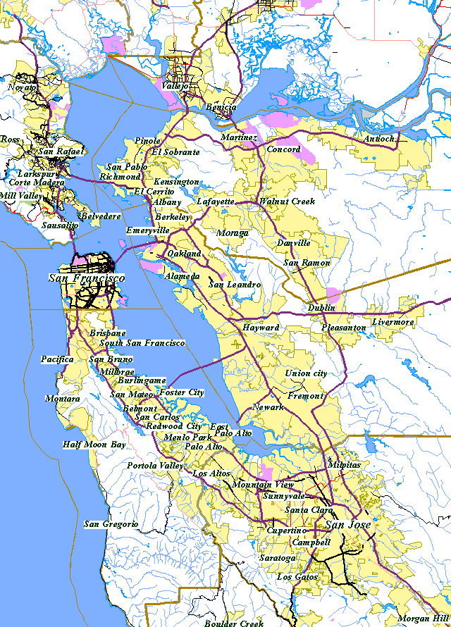
San Francisco Bay Area
Alameda
SF
Castro Valley
Hayward
Notes:
We first lived in Alameda across the bay from San Francisco, then later in two other cities.

Slide 36
The Divorce
1962
Navy Commander
Harold F. Griffith (alias Dad)
Social Worker
Joyce I. Griffith (alias Mom)
Notes:
After my younger brother's birth my Mom concluded that my Dad was actually married to the Navy, so she divorced him. Ironically, she became a social worker to help other families put their lives together.

Slide 37
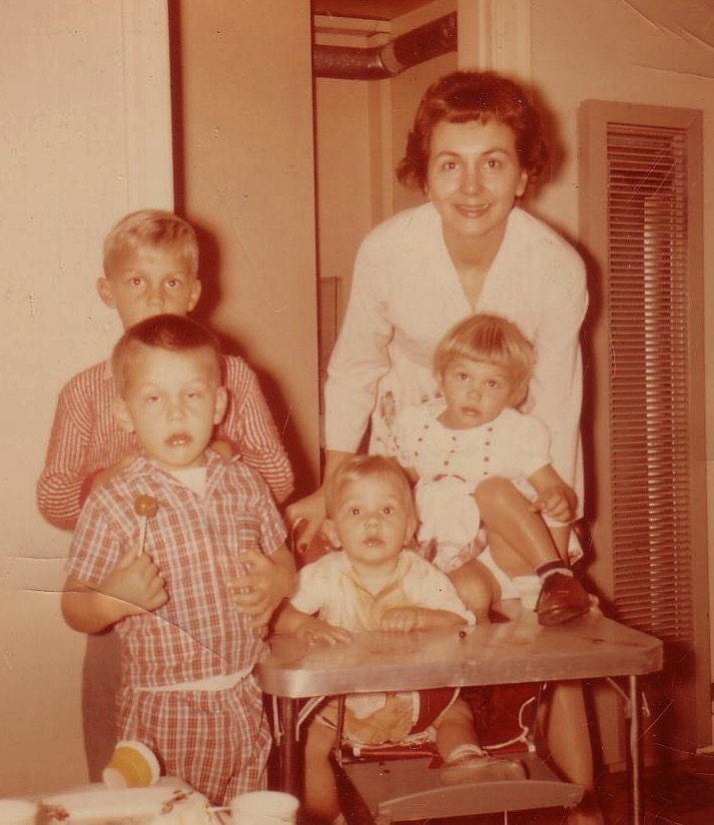
Divorce for Mom was tough…
Bobby, 6
Ricky, 4
Kathy, 3
Tommy, 1
Notes:
Those were tough years for Mom as a single mother with four kids age 6 and under. Yes, I'm the good looking one with the sucker!

Slide 38
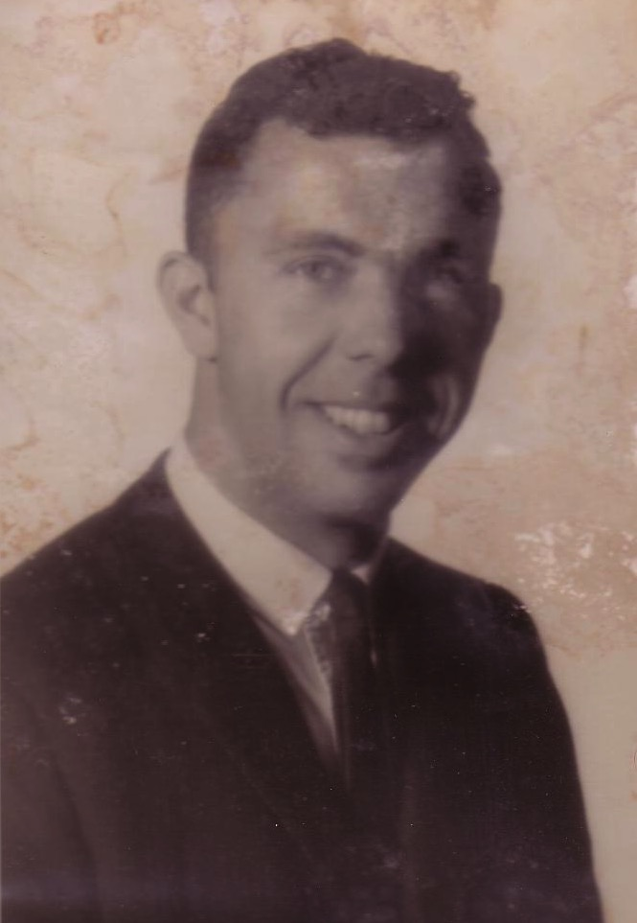
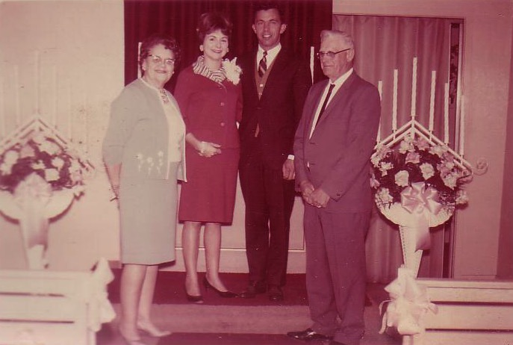
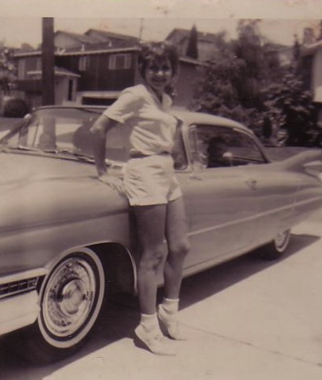
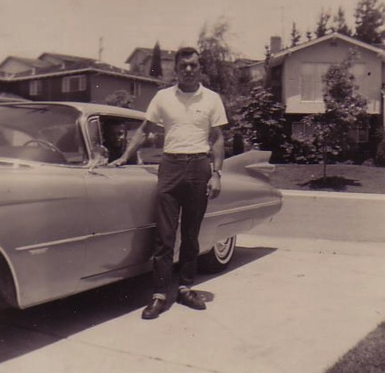
Renewal Under Bill
Notes:
Three or four years later my Mom met Bill—another divorcee with three children. They married once when I was on vacation to see my real Dad.

Slide 39
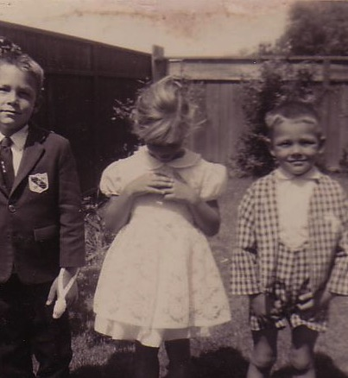
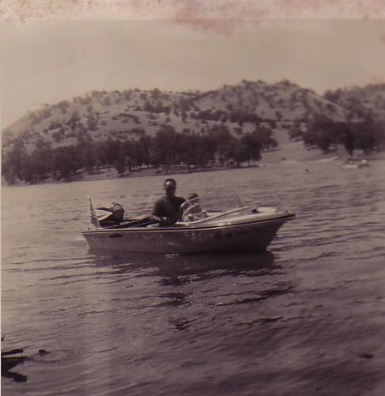
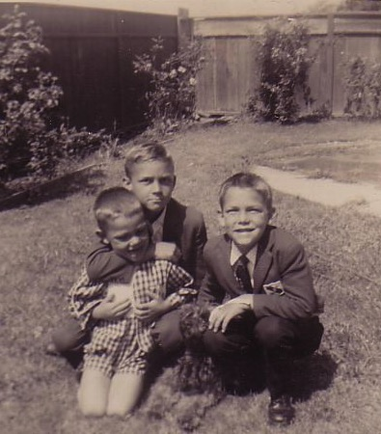
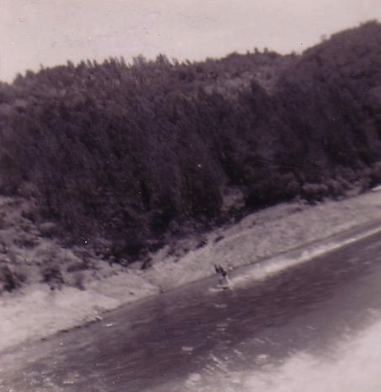
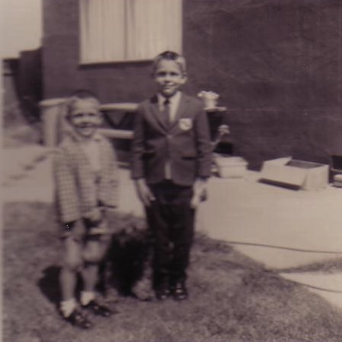
One Year of Water Skiing…
& One Year of Church…
1966-1968
Notes:
Life began to turn around. Bill played sports with us and even took us to church for a year.

Slide 40
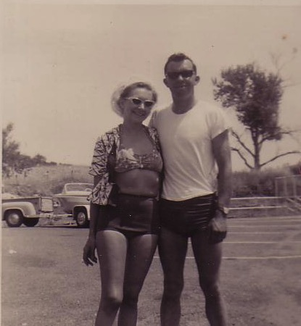
Another Divorce…
Notes:
But the arguments with my Mom became unbearable so my Mom divorced him too.

Slide 41
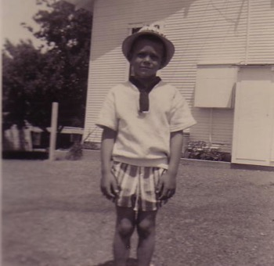
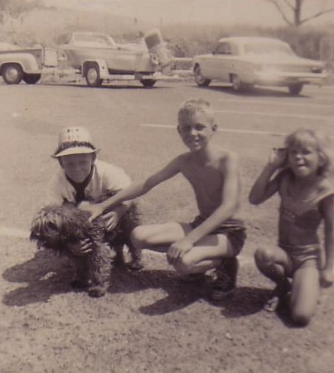
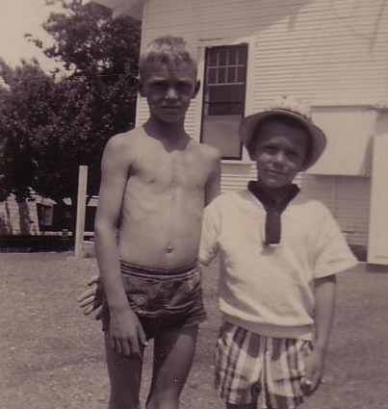
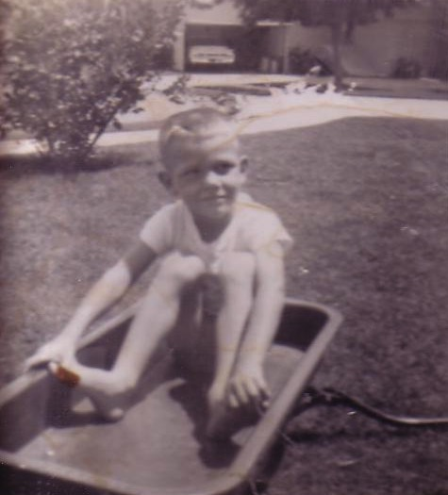
But We Had Each Other…
Notes:
You may think I was lonely—but I had my big brother Bob and my sister Kathie. My little brother Tom was a pest.

Slide 42
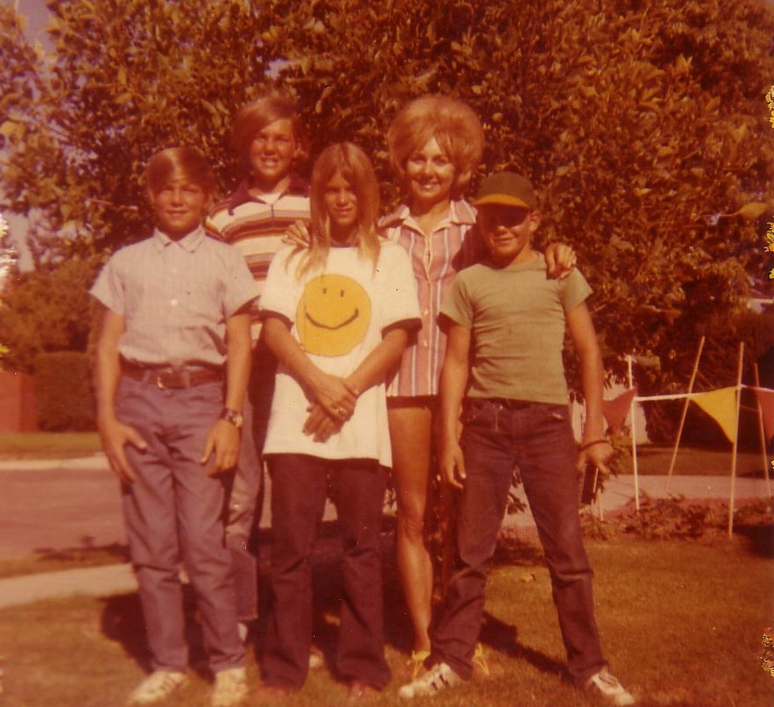
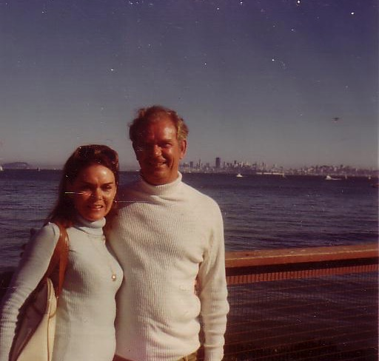
Our Family of 5 (1972)
Notes:
But we learned to live without a Dad again while my real Dad married a third time—actually five times total!

Slide 43






School Pictures
Kindergarten
Grade 1
Grade 2
Grade 3
Grade 4
Grade 5
Notes:
Life went on and, despite my rotten family background, I sensed that there was a God—so I figured that I better be a good boy. I obeyed my parents and did well in school and sports over the years.

Slide 44


Baseball
Notes:
Of course, when Sunday morning came I still played baseball.

Slide 45




Peppy Sports
Notes:
My siblings and I even dressed our dog Peppy up to play baseball—as well as hiking, football, and basketball. Yes, don't remind me that my hands are in the basketball picture. My brother didn't frame it right!

Slide 46


My Spiritual Journey
Notes:
It's been said that our view of the Heavenly Father follows our view of our earthly father. My father was an important man who achieved the rank of Captain. He loved me but was always far away fighting in Vietnam, so I saw God the same—One who loved me but was far away doing important things.

Slide 47


Searching in the 70s…
Love
Notes:
I was too young to be a hippie, but I did identify with the search for love and peace. I painted in bright fluorescent colors the love and peace signs on my bedroom wall, turned on my black light, laid on my bed and said "groovy," "far out," and other things hoping that real peace would fill my heart. It didn't!

Slide 48
What will the kids remember?
Notes:
Mothers, what will your kids remember most about you when they grow up?
Your pushing and pushing for them to get good grades? Moodiness?
Let your children remember you most for your godliness!

Slide 49

Our mothers are the greatest single tool of God to help us influence the lives of others
Notes:
No person can train us better to serve Christ than our mother.

Slide 50

Timothy's City of Service
Notes:
Timothy grew up to be a tremendous tool of God due to his mother's influence.

Slide 51
The Man Timothy
• "Disciple" from Lystra (Acts 16:1)
• "Brothers spoke well of him" (Acts 16:2)
• "Son in the faith" (1 Tim. 1:2)
• Traveled with Paul (Acts 16–18)
• Pastored church at Ephesus (1 Tim. 1:3)
• At Paul's death (asked for in 2 Tim. 4:9)
• Blessed by Lois and Eunice,
blessed Paul, and blesses us!
Notes:
Even when Paul met him he was called a "disciple" [Acts 16:1].
Due to his mother and grandmother's influence Timothy had a good reputation not only in his hometown (Lystra) but also nearby towns like Iconium.
Soon Paul would call him his "son in the faith," meaning his younger fellow-worker who was so close that he was like a son [2 Tim 1:2; 2:1; 1 Tim 1:2].
Timothy became the constant companion of the greatest apostle ever to live, even though he was a very young man. Fifteen years after he started traveling with Paul the apostle told him “don't let anyone despise your youth” so he was young when used of God! (By the way, don’t believe the lie that the youth are the church of tomorrow. They are the church of today!)
God had Timothy minister to Paul just before his execution. In 2 Timothy 4:9 Paul asks, "Do your best to come to me quickly" and he probably made it to Paul in time.
In a real sense, you and I are presently benefiting from the ministry of Lois and Eunice into Timothy who served Paul who gave us one half the New Testament! What an influence godly mothers can have!

Slide 52




Susanna Wesley
Samuel Wesley
John Wesley
Charles Wesley
Notes:
Susanna Wesley was such a woman also—with such an influence on her 19 children that most don't even know her husband's name, the Rev. Samuel Wesley.
You will recognize the names of two of her sons though:
• Charles Wesley wrote several hundred hymns, some of which are in your hymnal.
• John Wesley became the founder of Methodism—a denomination whose influence has been strong for the cause of Christ through the centuries.
These two sons, under God, brought revival to England while France underwent a bloody revolution.
Susanna Wesley impacted all of England through her children! But how?
**She spent one hour each and every day shut up with God alone in her room, praying for her 19 children by name. She also had several rules (Tan 3653):
1) No child was given anything because he cried for it… (In her house the kids rarely cried loudly).
2) No eating and drinking between meals, except when sick.
3) At 7 PM, each child was put to bed; at 8 PM she left the room. She never allowed herself to sit by the bed until the child fell asleep.
4) The little ones had their own table near the main table. When they could handle the fork and knife, they were "promoted" to the family table.
5) Each child had to eat and drink everything before him.
6) Children had to address each other as "Sister ______" or "Brother _____."
7) She never showed anger or scolded. She would always explain and explain.
** You can trace the legacy of her children down through the centuries. Her godly life multiplied into the lives of her children and into your life and mine.

Slide 53

Susan's Parents
Kurt & Doris
Notes:
A modern-day example of this kind of influence is my wife's family background.
Susan's Mom (Doris) and grandmother (Signe) never served in full-time ministry.

Slide 54

The Crossroads (1981-83)
Notes:
Yet their influence in Susan's life has reached literally hundreds of thousands of people for Christ through her daughter through an evangelistic singing group that shared Christ throughout Asia [cf. “arrows” of Psalm 121].

Slide 55

Crossroads Ministry
Korea
China
Japan
Hong Kong
Taiwan
Macau
Thailand
Philippines
Malaysia
Singapore
Indonesia
Notes:
The Crossroads team shared the gospel in 11 Asian nations and saw over 10,000 people indicate decisions to trust Christ! Again I was amazed at God's grace!

Slide 56




China, 1981
Notes:
Our first tour to China we were celebrities as the first Christian musical team to visit the New China. We sang in music conservatories, parks, and even from the bus! God began to open my eyes to the needs of East Asia…

Slide 57


Marriage, 1983
Romance, 1982
Notes:
God also began to open my eyes to the woman singing next to me! She initially despised me but after a year or so she saw the light. That's our engagement picture. In 1983 we returned to the USA..

Slide 58


Influence Towards Evil
20 April 1889
Adolf Hitler
Notes:
However, since a mother's influence is so strong, the opposite situation can occur too—
One mother, although very religious, despised her son, mistreated him and belittled him to the point where one day the young lad of 17 years old got fed up with it all.
In the presence of his parents, he turned around on their farm and walked down the road, intending to never see them again. He didn't so much even turn around and wave, let along give his mother a "good-bye" hug.
• He walked off, his face set like a flint. He never did see them again. But his life did become one of influence, negative influence, and you know his name—Adolf Hitler.

Slide 59

Mother's Day should remind each of us of some important things
Notes:
I want to suggest an application for each of us no matter who we are.

Slide 60

Mother's Day should remind us of some important things…
For Mothers…
For Others: Those with Mothers living…
C. For Others: Mothers passed away…
Notes:
For mothers here today…
1. What kind of legacy are you leaving to your children? For what will they most remember you after they're gone?
2. What do you need to do to have them remember what you want them to remember?
a. Commit never to scold?
b. Begin that time of reading from the Bible each day with your child? One friend every morning had an individual quiet time with each of her 9, 7, and 3-year-old kids.
c. Some of us may need to quit our job to give that kind of care! After all, the only command to mothers in Scripture is Titus 2:5 that says they should be “busy at home.”
For those with mothers still living…
1. Flowers, cards, gifts, letters, phone calls… these are good and important.
2. But today praise your mother for a character quality she invested into your life.
a. At our wedding Susan and I took about ten minutes expressing to our parents appreciation for the character qualities they had invested in our lives. I thanked my Mom for her encouragement.
b. What positive trait can you thank your Mom for today? Prayer life? Commitment to Scripture? Hospitality? Compassion? Discipline?
(Some of you are saying, "I can't do these things since my mother isn't alive anymore…")
• Passed
C. For you whose mothers have passed away…
1. Write her a letter—tell her things you wished you had expressed when she was alive.
2. A friend of mine did this many years ago and found that it really relieved her of an incredible amount of stress.
(What have I been saying this morning? Simply this…)

Slide 61

Main Idea (Again)
A mother's influence is the most powerful force in the world!
Notes:
No other influence on your life has matched that of your mother! [Restatement]

Slide 62


"The hand that rocks the cradle…
…rules the world"
Notes:
There’s a great amount of truth to the old cliché, “The hand that rocks the cradle rules the world”—for good in the case of Timothy and for evil in the case of Hitler.

Slide 63

Poem
If you have a smile for Mother,
Give it now.
If you have a kind word,
Speak it now.
If you have a flower for Mother,
Share it now.
She'll not need it when the angels greet her at the golden gate;
Give the smiles while she is living;
If you wait it may be too late.
Notes:
Whatever good you do, do it now!

Slide 64
Black

Slide 65


NT Preaching link at BibleStudyDownloads.org
Get this presentation and script for free!
Notes:
NT Preaching (np)

